Slide 1
Pitch Recognition and Sequencing Analysis for MLB Athletes
Sean W. Ryan

Slide 2
Introduction
Objective:
Analyze pitch sequences and understand how pitchers approach hitters based on MLB Statcast data from the 2024 regular season.
Purpose:
Identify patterns in outcomes of common pitch sequences (e.g. back-to-back changeups resulting in a ball 40% of the time), to help create training scenarios in WIN Reality VR hitting training.

Slide 3
Data Overview
Dataset: MLB Statcast data (2024 season) retrieved using the pybaseball library.
Data includes over 690,000 rows with 94 columns covering various pitch attributes (pitch type, speed, outcome, etc.).
Tools Used:
Python: Data processing and analysis.
pandas, seaborn, matplotlib: For data exploration and visualization.
Google Colab: Platform for coding and visualization.
Key Metrics: Pitch type, speed, sequence outcomes (balls, strikes, hits, etc.).

Slide 4
Data Exploration
The dataset provided an extensive range of pitch-level data, which was filtered down to focus on key columns for analysis, such as pitch_type, release_speed, and events.
Visualizations:
Pitch Type Distribution: Most frequent pitch types (FF - Fastball, SL - Slider, CH - Changeup, etc.).
Pitch Speed Distribution: Range of pitch speeds, with a concentration between 85-100 mph.

Slide 5
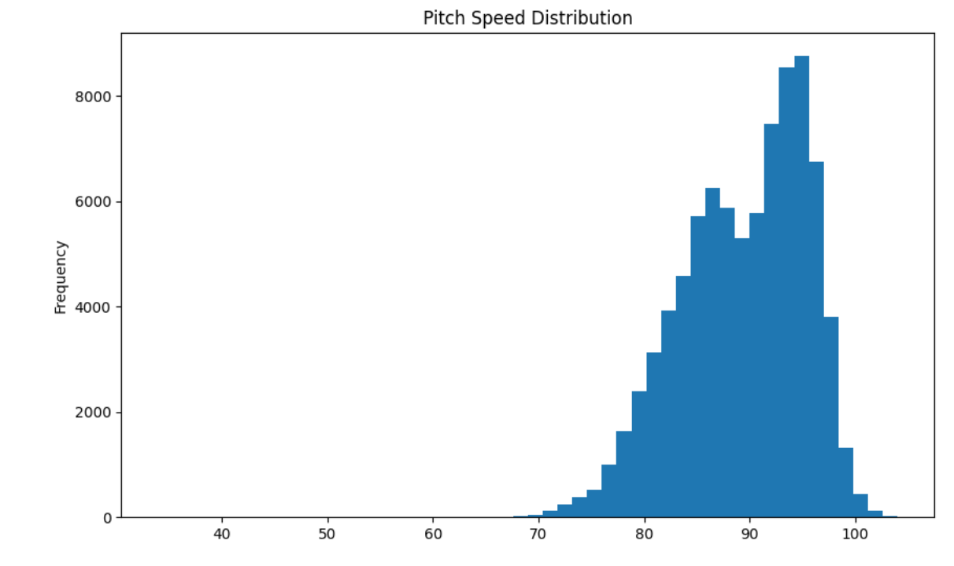
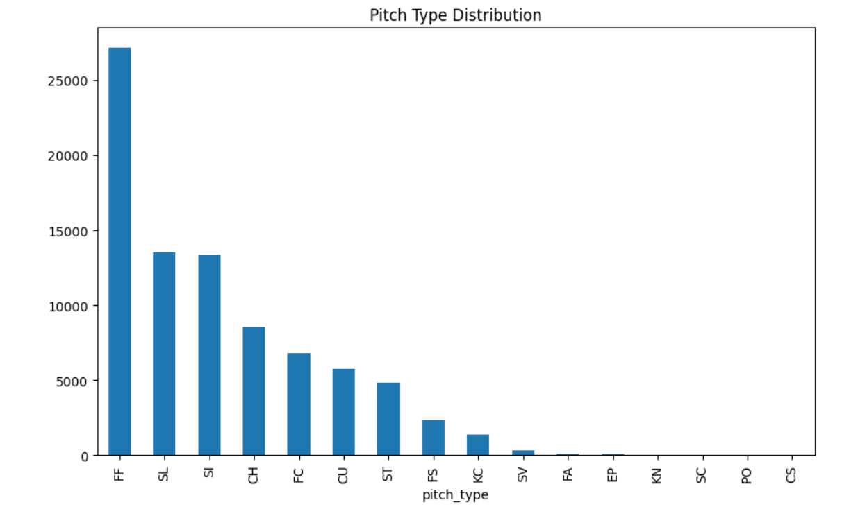
Data Exploration

Slide 6
Methodology
Data Cleaning:
Removed irrelevant columns and filled missing values.
Created a feature for previous pitch (lag variable) to analyze pitch sequences.
Top Pitch Sequences:
Grouped data by prev_pitch and pitch_type to identify the top 10 most common sequences.
Outcome Analysis:
Analyzed the distribution of outcomes (ball, strike, foul, etc.) for each pitch sequence.

Slide 7
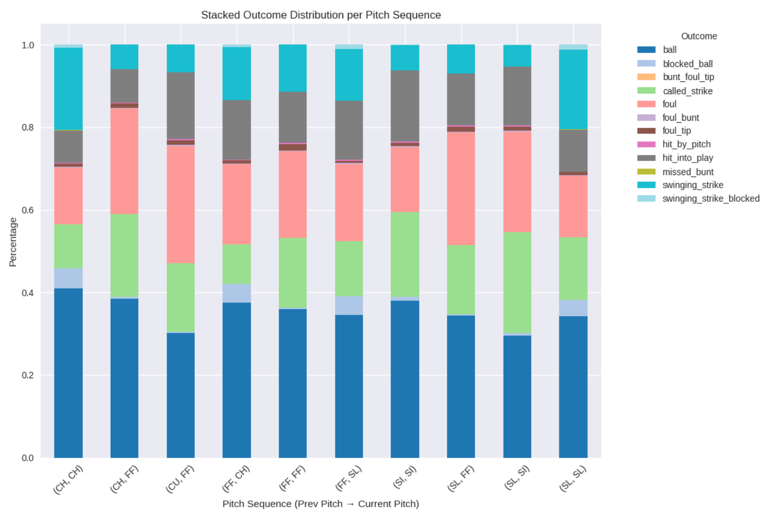
Pitch Sequence Outcome Analysis

Slide 8
Key Insights for Player Training
This analysis provides insights that could benefit virtual reality training in baseball:
Pitch Recognition: Hitters can focus on identifying key pitch sequences (e.g., fastball followed by slider) and anticipate the most likely outcomes.
Improved Decision-Making: Understanding sequence outcomes helps batters adjust their swing or plate discipline based on probabilities.
VR Application: By integrating real-world pitch data, it allows you to simulate realistic pitch sequences and offer data-backed feedback for training.

Slide 9
Future Directions
To extend this project, here are potential next steps:
WAR Integration: Analyze the top pitchers by WAR (Wins Above Replacement) and compare their sequences to identify patterns among elite pitchers.
Machine Learning: Build predictive models to determine the next likely pitch based on previous sequences and contextual data (balls, strikes, count, etc.).
Player-Specific Training: Customize virtual training drills based on a player's historical performance against specific sequences, enhancing individualized improvement plans.

Slide 10
Conclusion
This project showcases how MLB pitch data can be leveraged to uncover key insights in pitch sequencing and recognition. By integrating this analysis into VR training, players can gain an edge by improving their pitch recognition and decision-making.
This project aligns with WIN Reality’s goals of using data analytics to enhance player performance, and I look forward to continuing my application of these skills in this exciting area.

Slide 11
Thank You!
Sean W. Ryan
Email: seanwryan17@gmail.com
Phone: +1 (609) 273-9328
LinkedIn: https://www.linkedin.com/in/seanwryan17/
GitHub: https://github.com/seanwryan
This project utilized insights and assistance from ChatGPT, an AI language model developed by OpenAI, to support coding and conceptualization.

